Slide 1
Lecture 10:
Recurrent Neural Networks

Slide 2
Administrative
Midterm this Wednesday! woohoo!
A3 will be out ~Wednesday

Slide 3
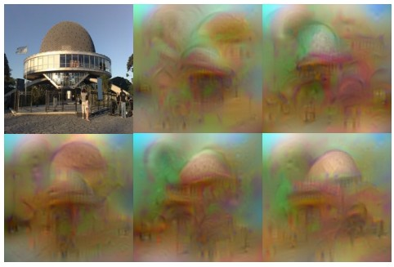
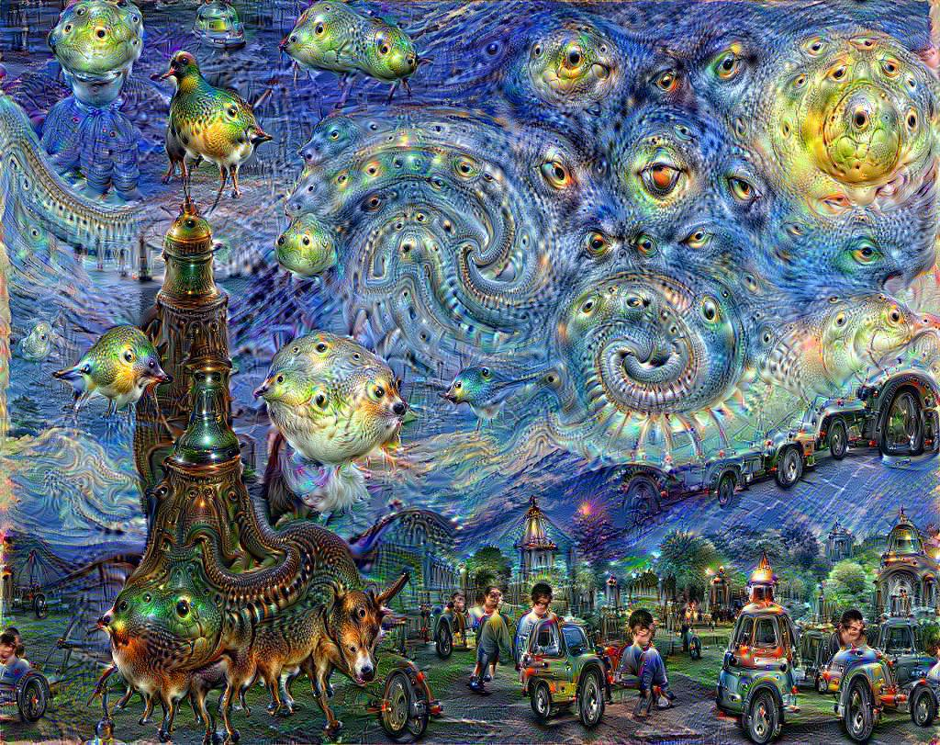
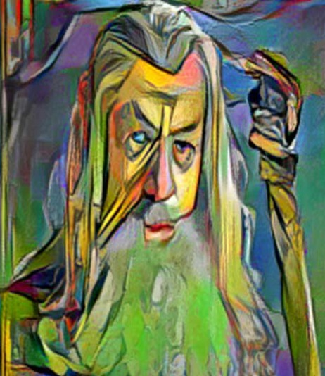
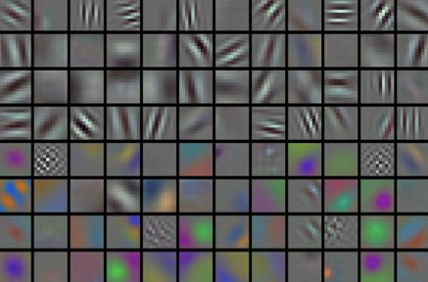
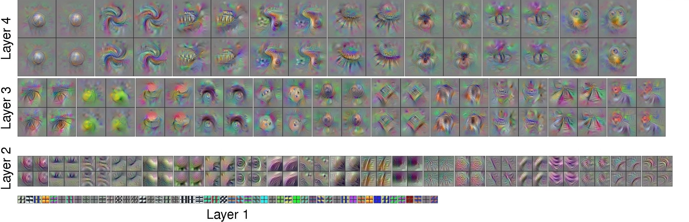
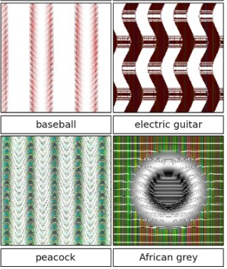

Slide 4
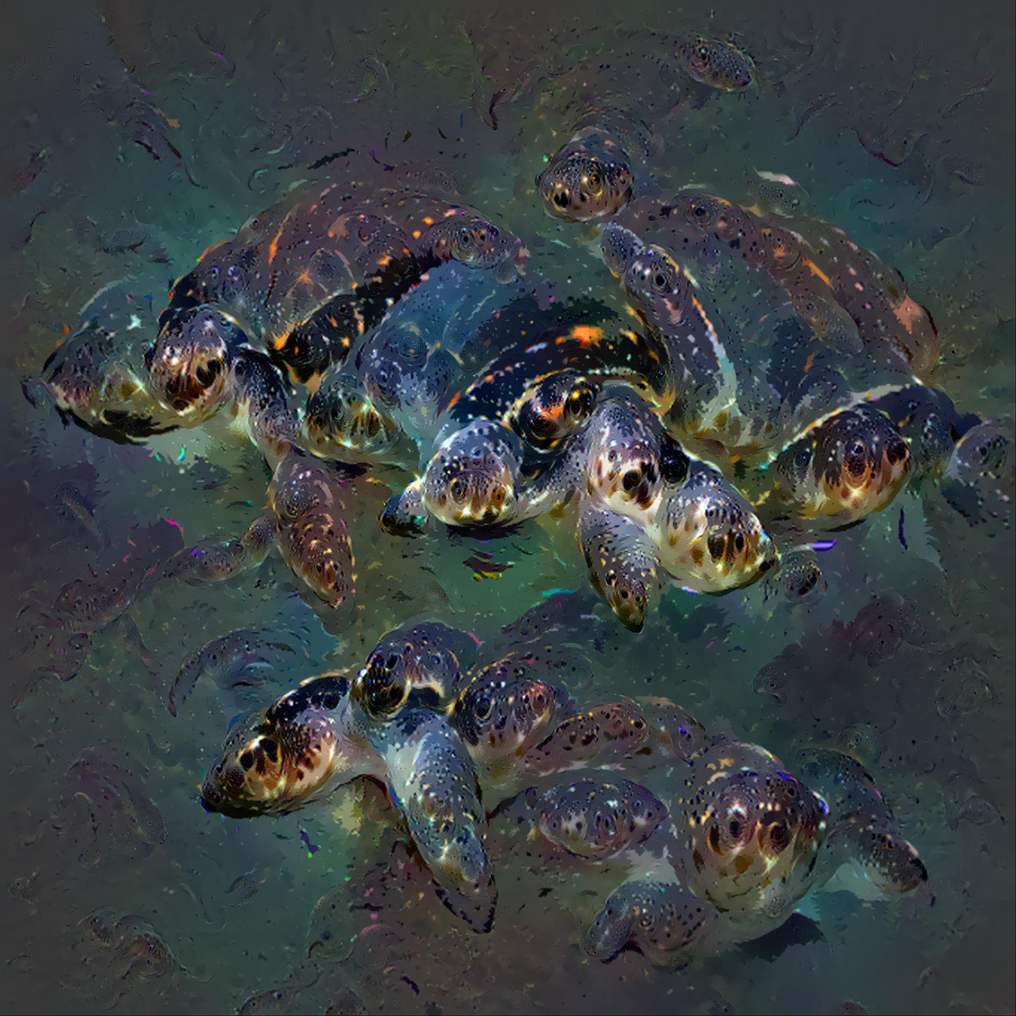
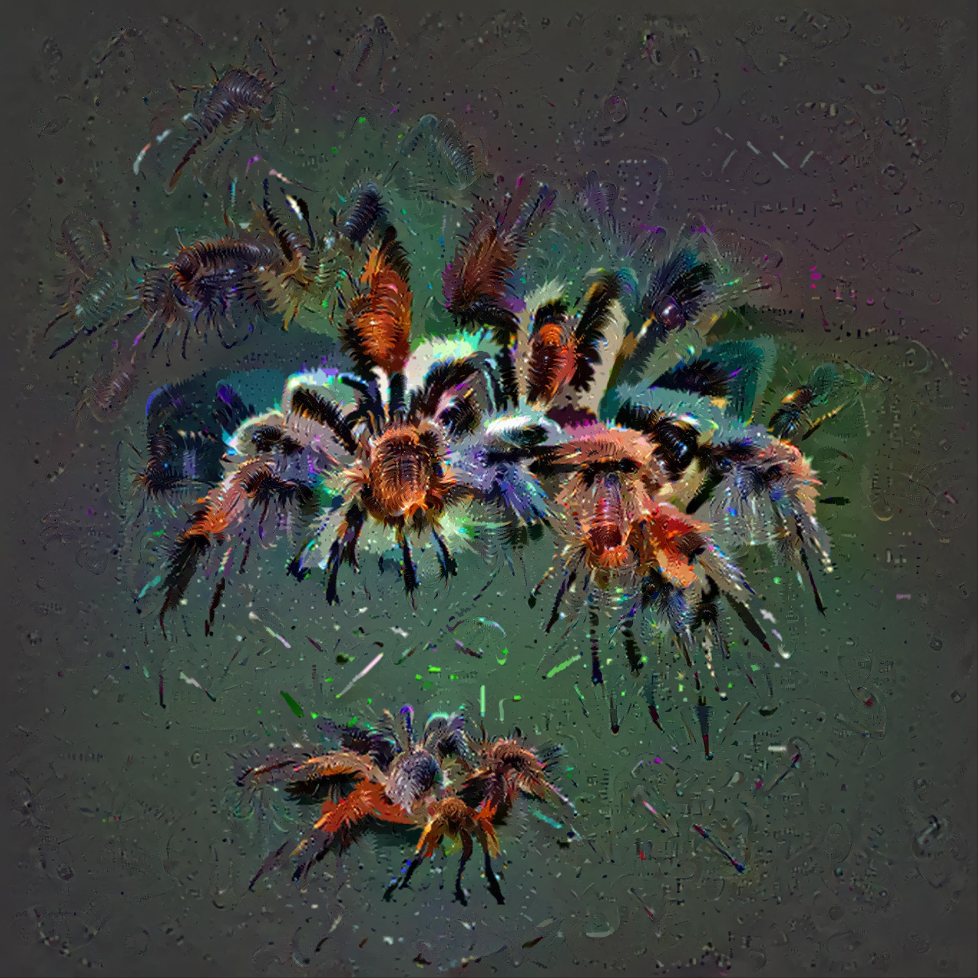
http://mtyka.github.io/deepdream/2016/02/05/bilateral-class-vis.html

Slide 5
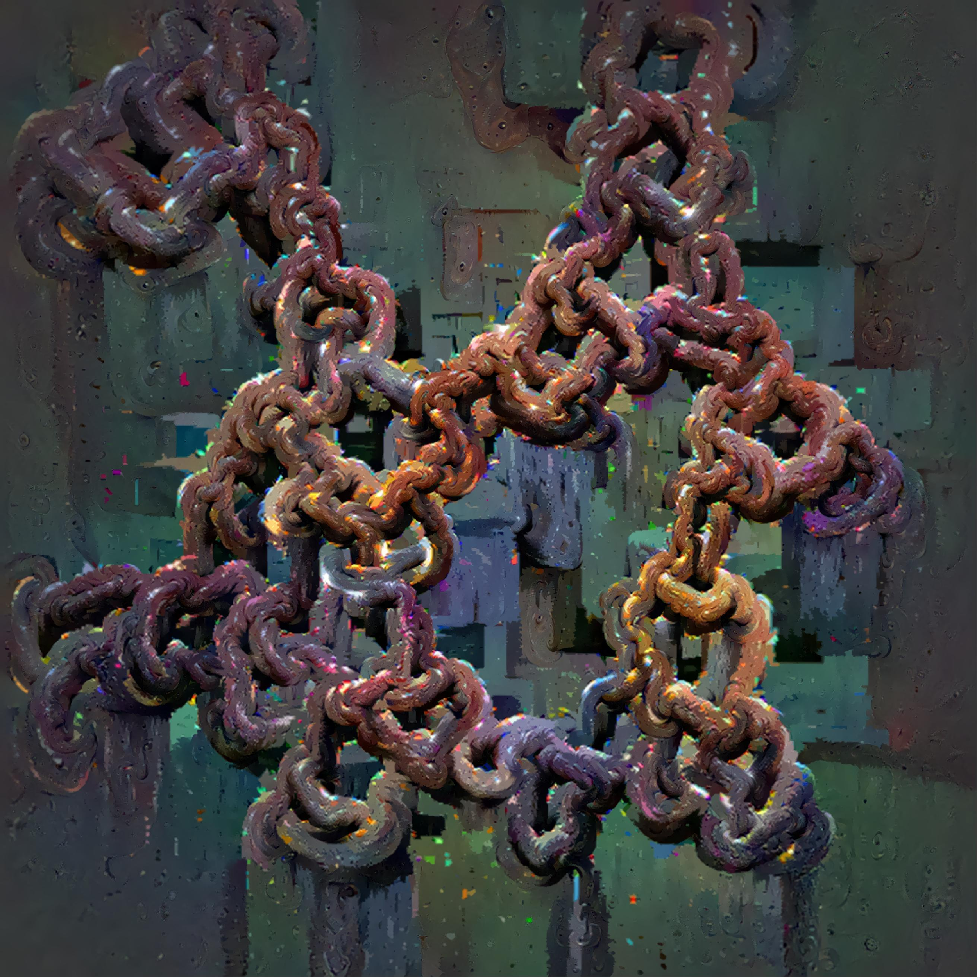
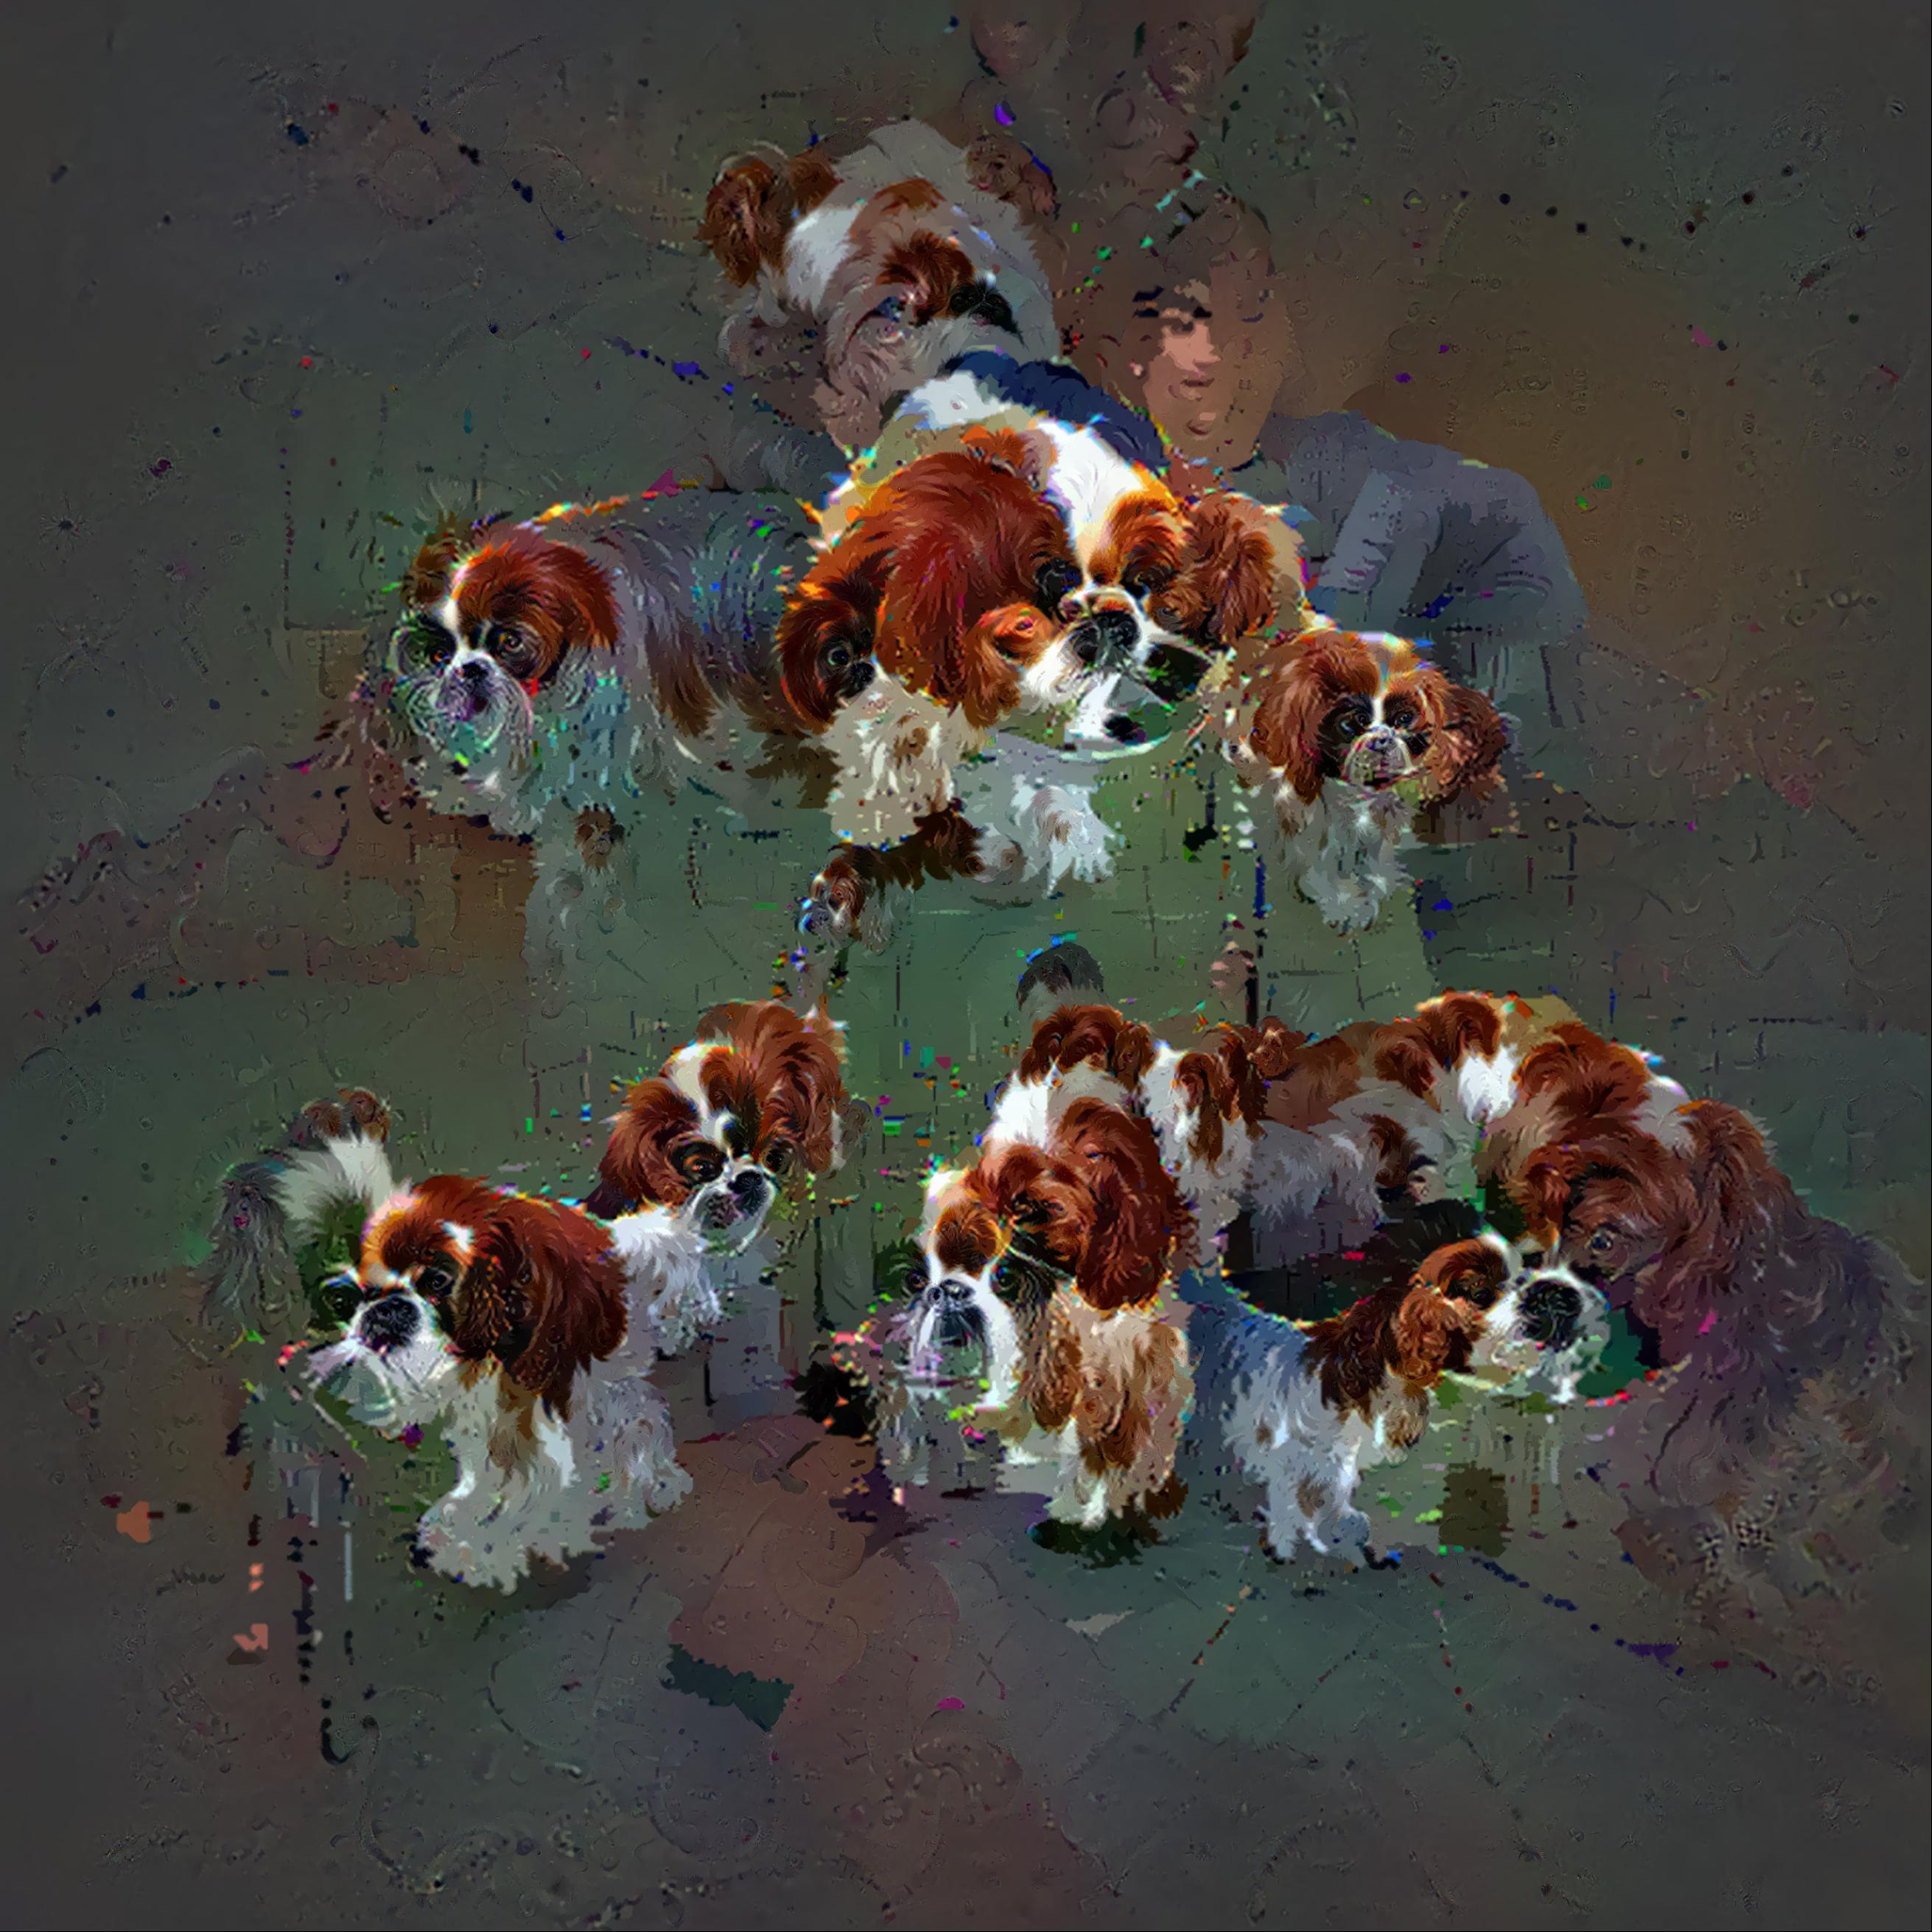
http://mtyka.github.io/deepdream/2016/02/05/bilateral-class-vis.html

Slide 6

Recurrent Networks offer a lot of flexibility:
Vanilla Neural Networks

Slide 7
Recurrent Networks offer a lot of flexibility:
e.g. Image Captioning
image -> sequence of words

Slide 8
Recurrent Networks offer a lot of flexibility:
e.g. Sentiment Classification
sequence of words -> sentiment

Slide 9
Recurrent Networks offer a lot of flexibility:
e.g. Machine Translation
seq of words -> seq of words

Slide 10
Recurrent Networks offer a lot of flexibility:
e.g. Video classification on frame level

Slide 11
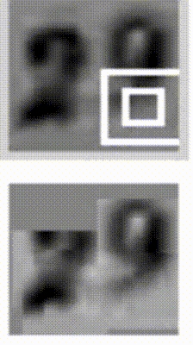
Sequential
Processing
of fixed
inputs
Multiple Object Recognition with Visual Attention, Ba et al.

Slide 12
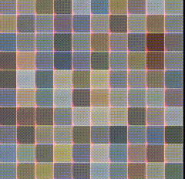
Sequential
Processing
of fixed
outputs
DRAW: A Recurrent Neural Network For Image Generation, Gregor et al.

Slide 13
Recurrent Neural Network
RNN
x

Slide 14
Recurrent Neural Network
y
usually want to predict a vector at some time steps
RNN
x

Slide 15
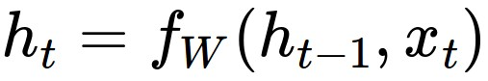
Recurrent Neural Network
We can process a sequence of vectors x by applying a recurrence formula at every time step:
y
RNN
new state
old state
input vector at some time step
some function
with parameters W
x

Slide 16
Recurrent Neural Network
We can process a sequence of vectors x by applying a recurrence formula at every time step:
y
RNN
Notice: the same function and the same set of parameters are used at every time step.
x

Slide 17
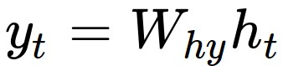
(Vanilla) Recurrent Neural Network
The state consists of a single “hidden” vector h:
y
RNN
x

Slide 18
y
Character-level
language model
example
Vocabulary:
[h,e,l,o]
Example training
sequence:
“hello”
RNN
x

Slide 19
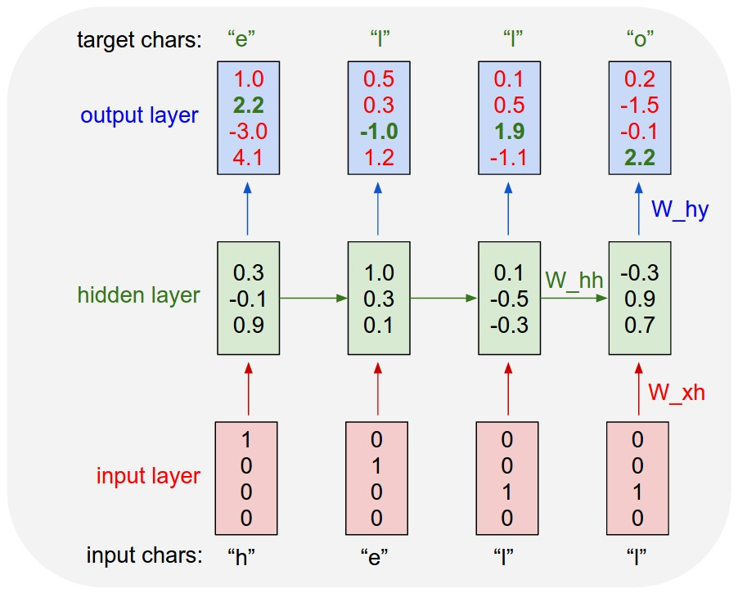
Character-level
language model
example
Vocabulary:
[h,e,l,o]
Example training
sequence:
“hello”

Slide 20
Character-level
language model
example
Vocabulary:
[h,e,l,o]
Example training
sequence:
“hello”

Slide 21
Character-level
language model
example
Vocabulary:
[h,e,l,o]
Example training
sequence:
“hello”

Slide 22
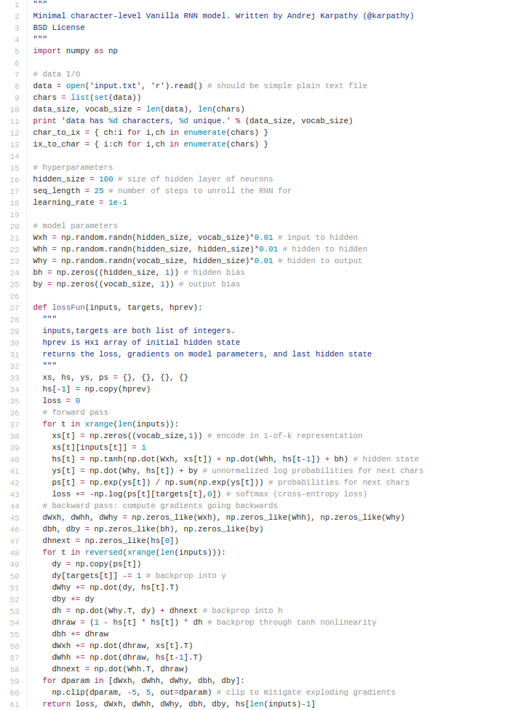
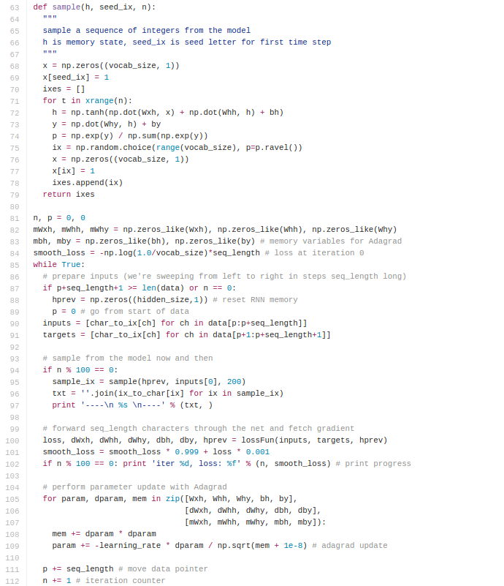
min-char-rnn.py gist: 112 lines of Python
(https://gist.github.com/karpathy/d4dee566867f8291f086)

Slide 23
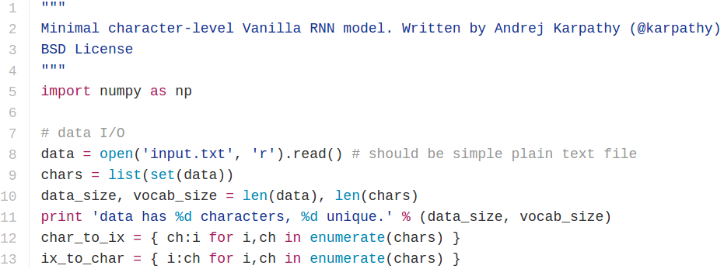
min-char-rnn.py gist
Data I/O

Slide 24
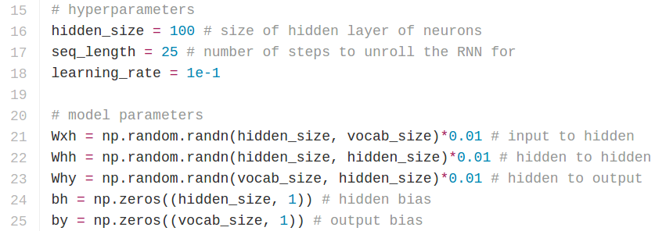
min-char-rnn.py gist
Initializations
recall:

Slide 25
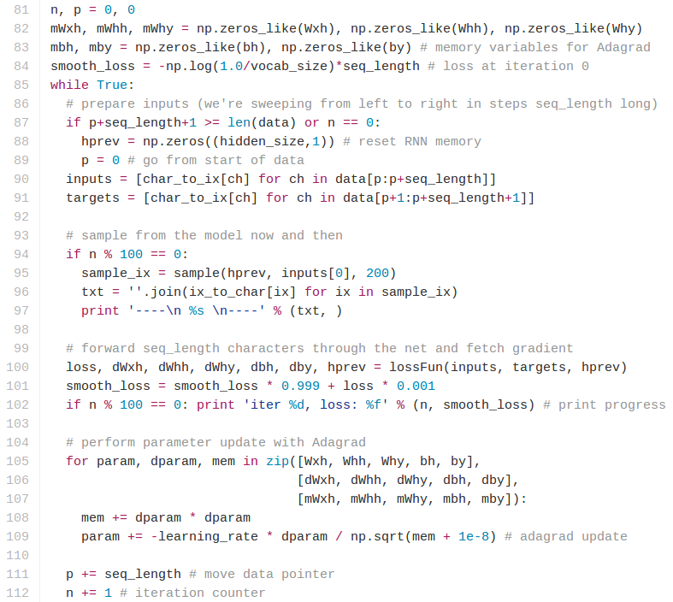
min-char-rnn.py gist
Main loop

Slide 26
min-char-rnn.py gist
Main loop

Slide 27
min-char-rnn.py gist
Main loop

Slide 28
min-char-rnn.py gist
Main loop

Slide 29
min-char-rnn.py gist
Main loop

Slide 30
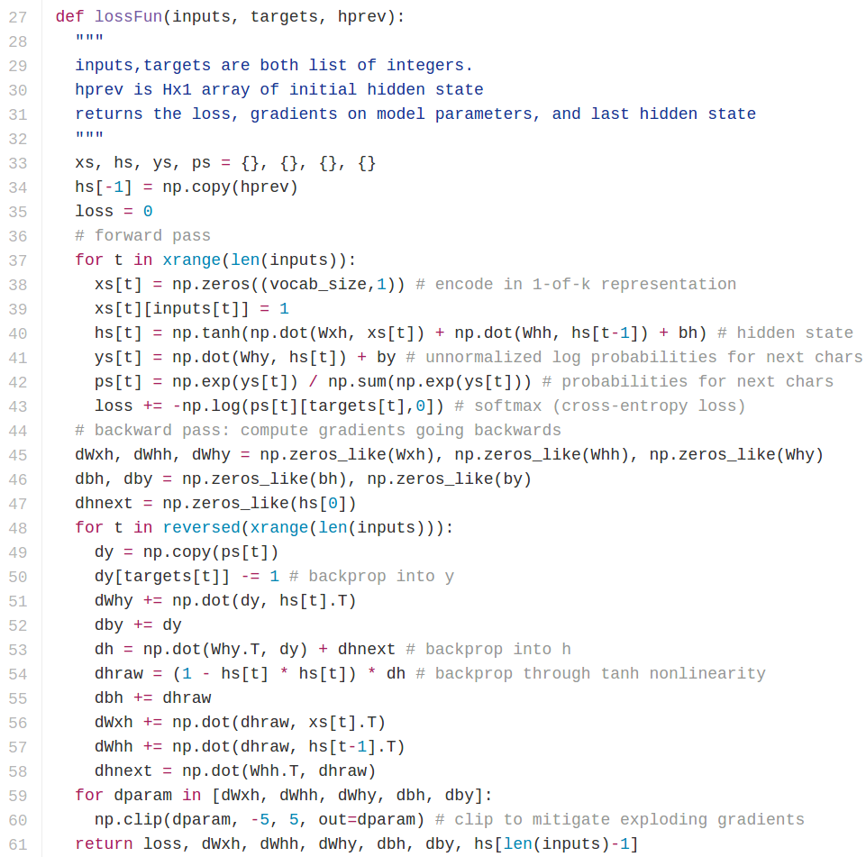
min-char-rnn.py gist
Loss function
forward pass (compute loss)
backward pass (compute param gradient)

Slide 31
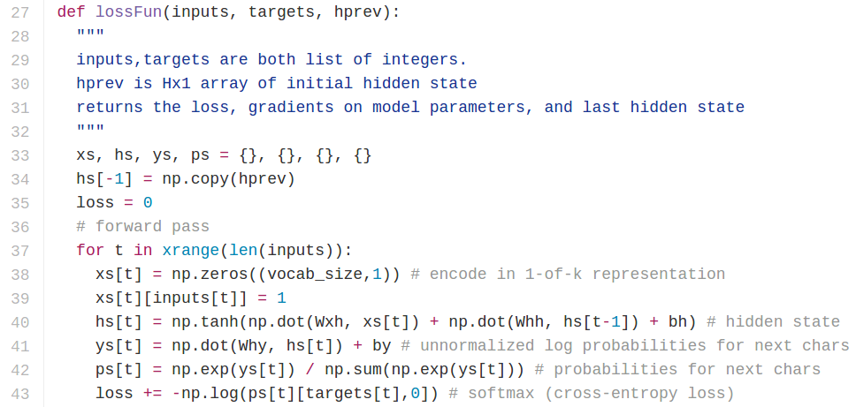
min-char-rnn.py gist
Softmax classifier

Slide 32
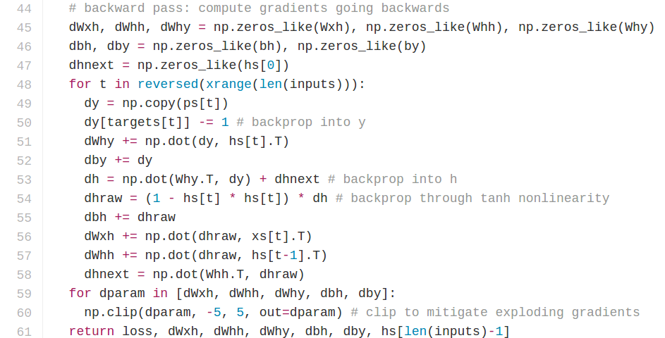
min-char-rnn.py gist
recall:

Slide 33
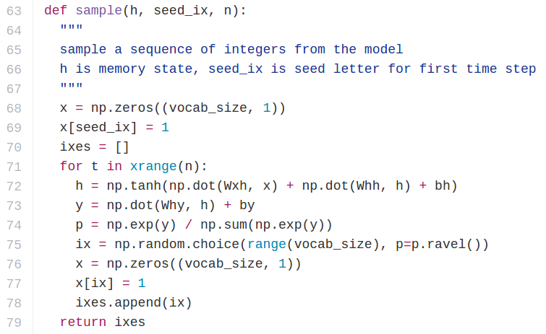
min-char-rnn.py gist

Slide 34
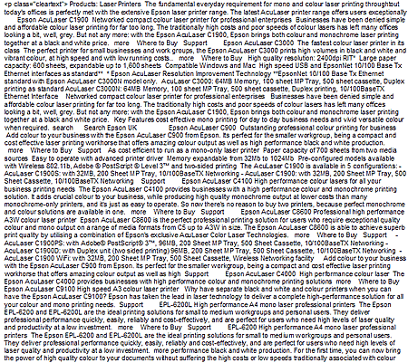
y
RNN
x

Slide 35
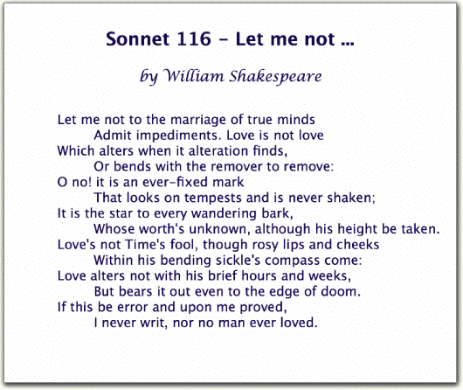

Slide 36
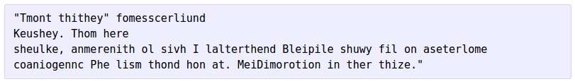
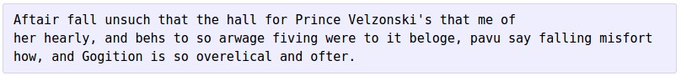
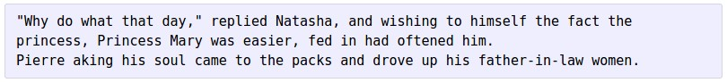
at first:
train more
train more
train more

Slide 37
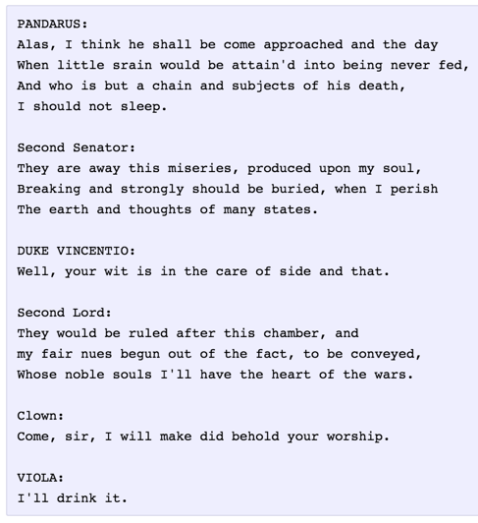
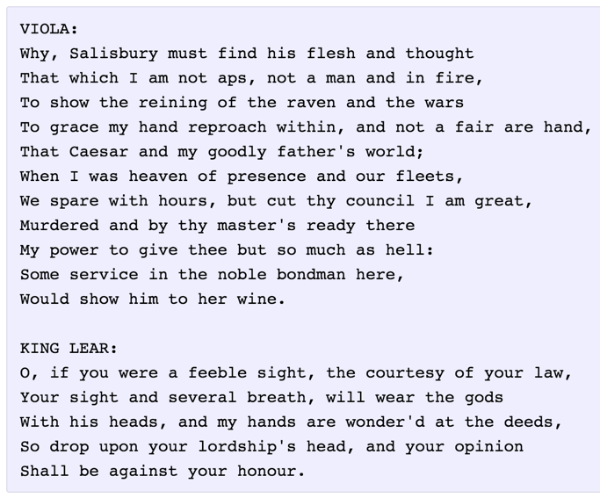

Slide 38
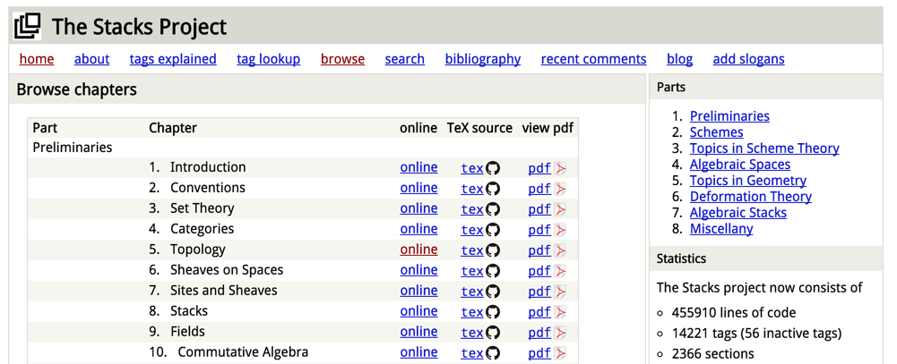
open source textbook on algebraic geometry
Latex source

Slide 39
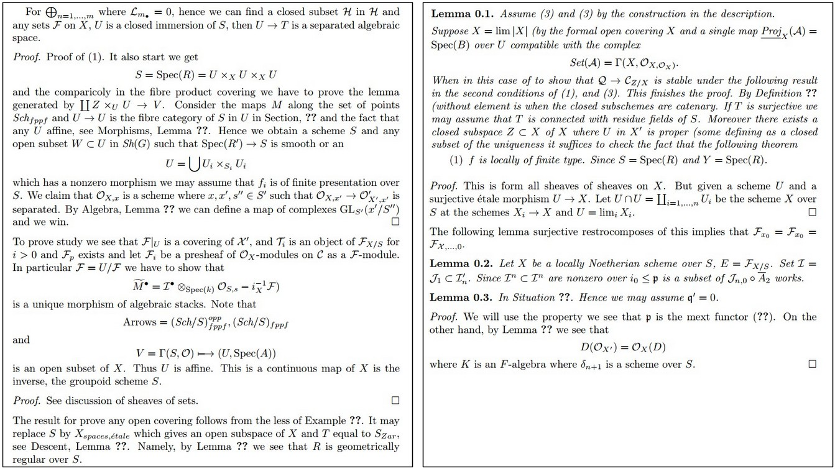

Slide 40
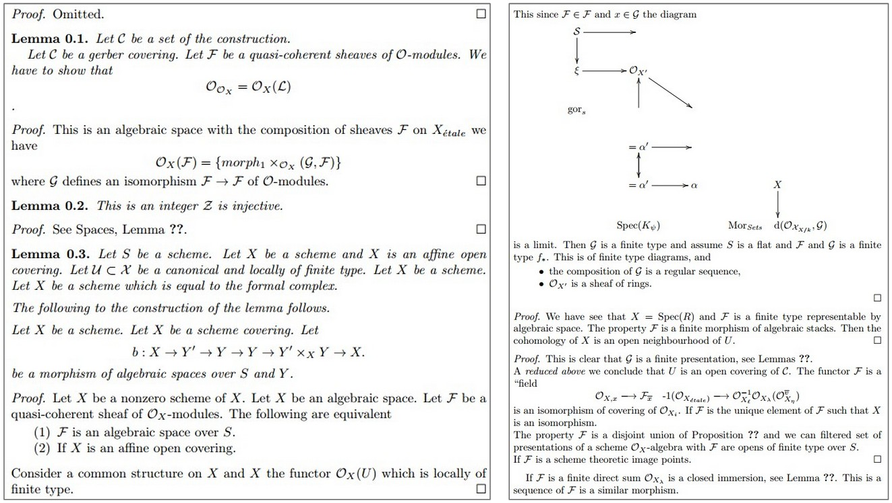

Slide 41
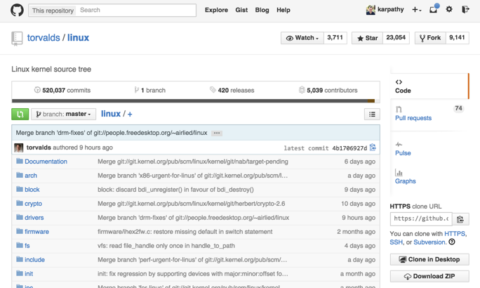

Slide 42
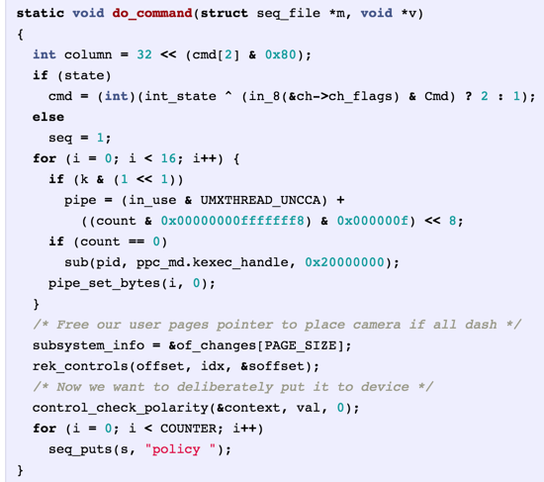
Generated
C code

Slide 43
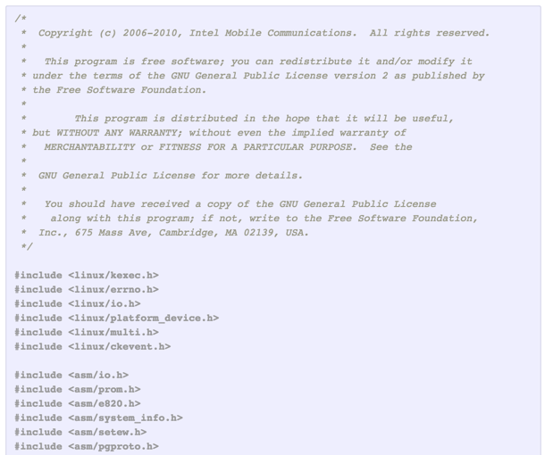

Slide 44
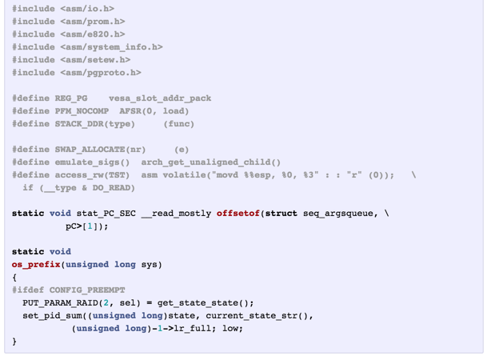

Slide 45
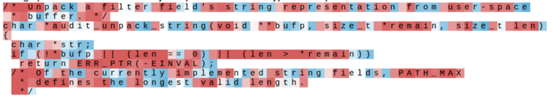
Searching for interpretable cells
[Visualizing and Understanding Recurrent Networks, Andrej Karpathy*, Justin Johnson*, Li Fei-Fei]

Slide 46
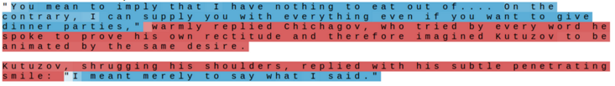
Searching for interpretable cells
quote detection cell

Slide 47
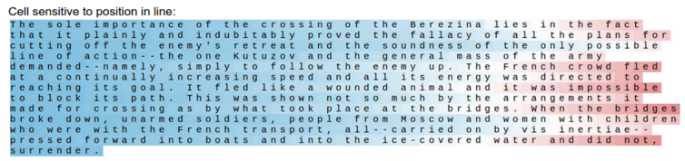
Searching for interpretable cells
line length tracking cell

Slide 48
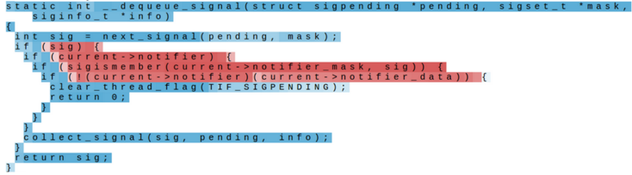
Searching for interpretable cells
if statement cell

Slide 49
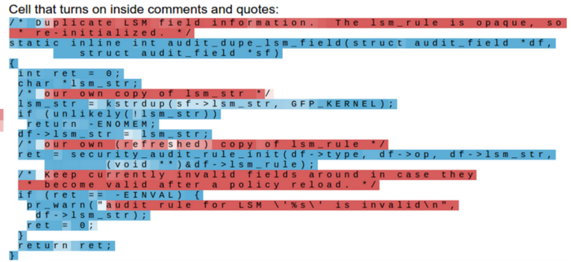
Searching for interpretable cells
quote/comment cell

Slide 50
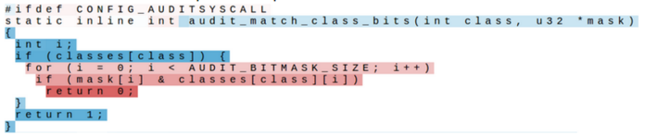
Searching for interpretable cells
code depth cell

Slide 51
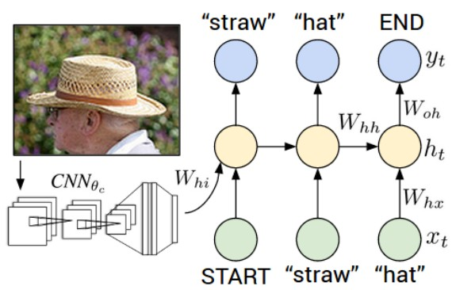
Image Captioning
Explain Images with Multimodal Recurrent Neural Networks, Mao et al.
Deep Visual-Semantic Alignments for Generating Image Descriptions, Karpathy and Fei-Fei
Show and Tell: A Neural Image Caption Generator, Vinyals et al.
Long-term Recurrent Convolutional Networks for Visual Recognition and Description, Donahue et al.
Learning a Recurrent Visual Representation for Image Caption Generation, Chen and Zitnick

Slide 52
Recurrent Neural Network
Convolutional Neural Network

Slide 53
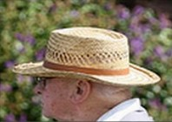
test image

Slide 54
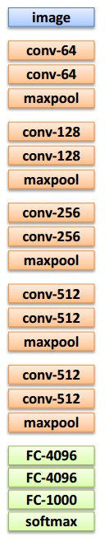
test image

Slide 55
test image
X

Slide 56
test image
x0
<START>
<START>

Slide 57
test image
y0
before:
h = tanh(Wxh * x + Whh * h)
now:
h = tanh(Wxh * x + Whh * h + Wih * v)
h0
Wih
x0
<START>
v
<START>

Slide 58
test image
y0
sample!
h0
x0
<START>
straw
<START>

Slide 59
test image
y0
y1
h0
h1
x0
<START>
straw
<START>

Slide 60
test image
y0
y1
h0
h1
sample!
x0
<START>
straw
hat
<START>

Slide 61
test image
y0
y1
y2
h0
h1
h2
x0
<START>
straw
hat
<START>

Slide 62
test image
y0
y1
y2
sample
<END> token
=> finish.
h0
h1
h2
x0
<START>
straw
hat
<START>

Slide 63
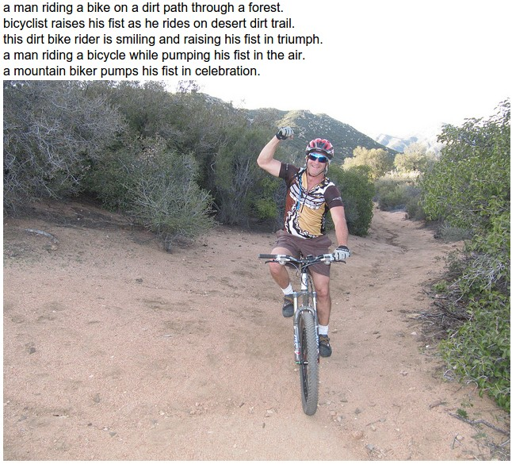
Image Sentence Datasets
Microsoft COCO
[Tsung-Yi Lin et al. 2014]
mscoco.org
currently:
~120K images
~5 sentences each

Slide 64
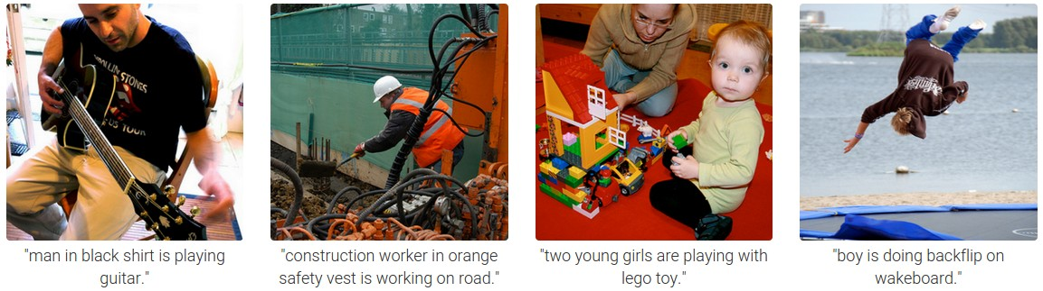

Slide 65
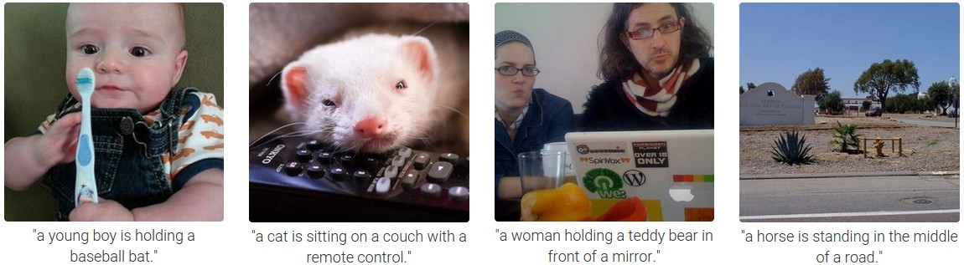

Slide 66

Preview of fancier architectures
RNN attends spatially to different parts of images while generating each word of the sentence:
Show Attend and Tell, Xu et al., 2015

Slide 67

RNN:
depth
time

Slide 68


RNN:
LSTM:
depth
time

Slide 69




LSTM

Slide 70
Long Short Term Memory (LSTM)
[Hochreiter et al., 1997]
vector from
below (x)
W
x
sigmoid
i
h
sigmoid
f
vector from
before (h)
sigmoid
o
tanh
g
4n x 2n
4n
4*n

Slide 71
Long Short Term Memory (LSTM)
[Hochreiter et al., 1997]
cell
state c
x
f

Slide 72
Long Short Term Memory (LSTM)
[Hochreiter et al., 1997]
cell
state c
x
+
x
f
i
g

Slide 73
Long Short Term Memory (LSTM)
[Hochreiter et al., 1997]
cell
state c
x
+
c
x
tanh
f
i
g
o
x
h

Slide 74
Long Short Term Memory (LSTM)
[Hochreiter et al., 1997]
higher layer, or prediction
cell
state c
x
+
c
x
tanh
f
i
g
o
x
h

Slide 75
LSTM
one timestep
one timestep
cell
state c
x
+
x
+
tanh
tanh
x
x
f
x
f
x
i
g
i
g
o
o
h
h
h
x
x

Slide 76
state
f
f
f
RNN
f
f
f
LSTM
(ignoring forget gates)
+
+
+

Slide 77



Recall:
“PlainNets” vs. ResNets
ResNet is to PlainNet what LSTM is to RNN, kind of.

Slide 78

Understanding gradient flow dynamics
Cute backprop signal video: http://imgur.com/gallery/vaNahKE

Slide 79
Understanding gradient flow dynamics
if the largest eigenvalue is > 1, gradient will explode
if the largest eigenvalue is < 1, gradient will vanish
[On the difficulty of training Recurrent Neural Networks, Pascanu et al., 2013]

Slide 80
Understanding gradient flow dynamics
if the largest eigenvalue is > 1, gradient will explode
if the largest eigenvalue is < 1, gradient will vanish
can control exploding with gradient clipping
can control vanishing with LSTM
[On the difficulty of training Recurrent Neural Networks, Pascanu et al., 2013]

Slide 81


LSTM variants and friends
[An Empirical Exploration of
Recurrent Network Architectures,
Jozefowicz et al., 2015]
[LSTM: A Search Space Odyssey,
Greff et al., 2015]
GRU [Learning phrase representations using rnn encoder-decoder for statistical machine translation, Cho et al. 2014]

Slide 82
Summary
RNNs allow a lot of flexibility in architecture design
Vanilla RNNs are simple but don’t work very well
Common to use LSTM or GRU: their additive interactions improve gradient flow
Backward flow of gradients in RNN can explode or vanish. Exploding is controlled with gradient clipping. Vanishing is controlled with additive interactions (LSTM)
Better/simpler architectures are a hot topic of current research
Better understanding (both theoretical and empirical) is needed.

